Slide 1

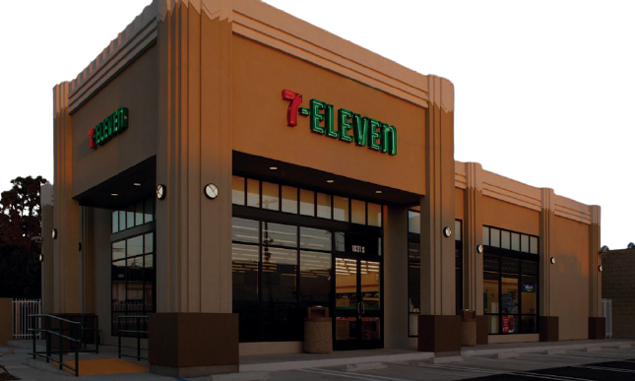
7-Eleven
Experimentation
Platform
7Eleven - Enterprise Data
Fall Internship Demo
By Kevin Kuo

Slide 2
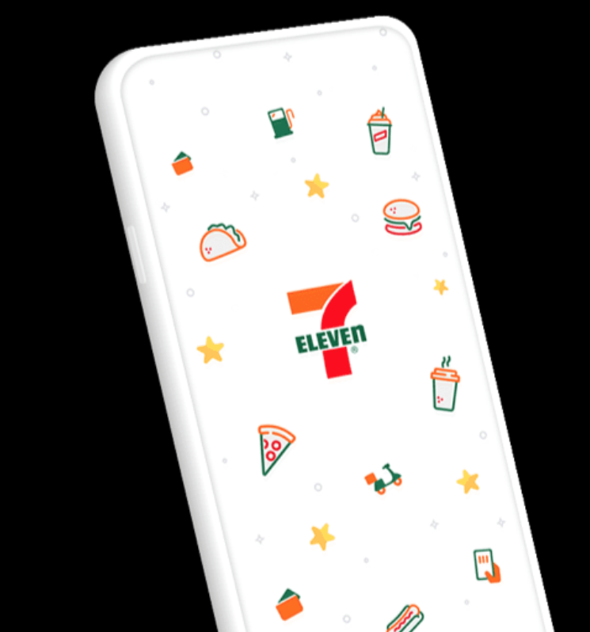
Agenda
7Eleven - Enterprise Data
7Eleven - Enterprise Data
1
A/B Testing
Experimentation Platform
Correlation
Interesting Findings
2
3
4

Slide 3

Slurpee Offer
7Eleven - Enterprise Data
How do we know if it is successful?
Increase in SLURPEE sales units:
SLURPEE Promotion?
Weather is too hot?
Any other factor….?

Slide 4
7Eleven - Enterprise Data
External
Factor
Weather
Season
City
Traffic
7-Eleven Market
Offer
Result
Internal
Factor
Cost
Shipment
Sold Out
Other

Slide 5
A/B Testing
7Eleven - Enterprise Data

Slide 6
A/B Testing
7Eleven - Enterprise Data
1. Select a group of target customers from the population:
Target Customers
e.g. People that came to 7-Eleven and bought something in the past 90 days

Slide 7
A/B Testing
7Eleven - Enterprise Data
2. Do a random split on the target customers into control and treatment group
Target Customers

Slide 8
A/B Testing
7Eleven - Enterprise Data
3. Give the offer only to treatment group, and leave all other factor the same:
Treatment Group
Control Group
SLURPEE Offer

Slide 9
A/B Testing
7Eleven - Enterprise Data
4. After the promotion ends, check the result, and see if there is a difference
SALES
Treatment Group
Control Group
TIME

Slide 10
Hypothesis Testing
7Eleven - Enterprise Data

Slide 11
Hypothesis Testing
7Eleven - Enterprise Data
1. Design the experiment and set the hypotheses
H0: the coffee sales units, on average, has no difference between treatment and control group
H1: the coffee sales units, on average, is better in treatment group than in control group

Slide 12
Hypothesis Testing
7Eleven - Enterprise Data
2. Create Cohort (Treatment & Control) using Stratified Random Sampling
For each Treatment and Control group, we want to simulate the target customers as much as possible
Male: 12 (60%)
Female: 8 (40%)

Slide 13
Hypothesis Testing
7Eleven - Enterprise Data
2. Create Cohort (Treatment & Control) using Stratified Sampling
Rule out the homogeneity factor that might potentially affect the result
Treatment:
Male: 9 (60%)
Female: 6 (40%)
Control:
Male: 3 (60%)
Female: 2 (40%)

Slide 14
Hypothesis Testing
7Eleven - Enterprise Data
3. After the experiment ends, compute the test score:
Mann-Whitney U test (Numerical): Test if two numerical variables have the same mean when the distribution of target customers are not normally distributed
Chi-Square test (Categorical): Test if two categorical variables are independent of each other

Slide 15
Statistically Significant
7Eleven - Enterprise Data
How do we know if the difference is large enough?
Scenario 1
Scenario 2
 | Size | Sales Units
Treatment | 10 | 55
Control | 10 | 12
 | Size | Sales Units
Treatment | 10,000 | 8900
Control | 10,000 | 8800
We Have to take Sample Size and Standard Deviation into consideration

Slide 16
Hypothesis Testing
7Eleven - Enterprise Data
4. Convert test score into p-value:
p-value : probability value, is a number describing how likely it is that H0 is true.
If p-value < 0.05, then it indicates strong evidence against the null hypothesis. (Less than 0.05 probability that null hypothesis is true)

Slide 17
Hypothesis Testing
7Eleven - Enterprise Data
5. Reject or Accept Null Hypothesis H0
H0: the sales units, on average, has no difference between treatment and control group
H1: the sales units, on average, is better in treatment group than in control group
P-value < 0.05, means that there is less than 5% probability that null hypothesis is correct.

Slide 18
Rfm Coffee Journey offer 1
7Eleven - Enterprise Data
Buy 1 and get 1 any size coffee for free
Treatment Group: 188,872 Loyalty Members
Control Group: 69,774 Loyalty Members
Duration: May 06th - May 15th, 2021

Slide 19
Hypothesis Testing
7Eleven - Enterprise Data
6. Provide a useful conclusion
Visualization
Power Analysis
Significance Test

Slide 20
Experimentation Platform
7Eleven - Enterprise Data
Automates the whole pipeline
Collect target customers criteria, and target KPIs from the end users
Create treatment and control groups
Keep track of the KPIs during the experiment
Analyze the result statistically
Display and visualize the result, and show statistical inference

Slide 21
Process
7Eleven - Enterprise Data
What we can do as an end users?
Before
Set Hypothesis
Proper Design the Experiment
Data Quality
Set Primary KPI and other Metrics
Create Treatment and Control

Slide 22
Process
7Eleven - Enterprise Data
What we can do as an end users?
Quick Diagnosis Weekly
Monitoring & Debugging
During
Before
Set Hypothesis
Proper Design the Experiment
Data Quality
Set Primary KPI and other Metrics
Create Treatment and Control

Slide 23
Process
7Eleven - Enterprise Data
What we can do as an end users?
Quick Diagnosis Weekly
Monitoring & Debugging
During
Before
After
Set Hypothesis
Proper Design the Experiment
Data Quality
Set Primary KPI and other Metrics
Create Treatment and Control
Statistical Analysis
Collect Useful Information from the Experiment
Draw a Conclusion

Slide 24
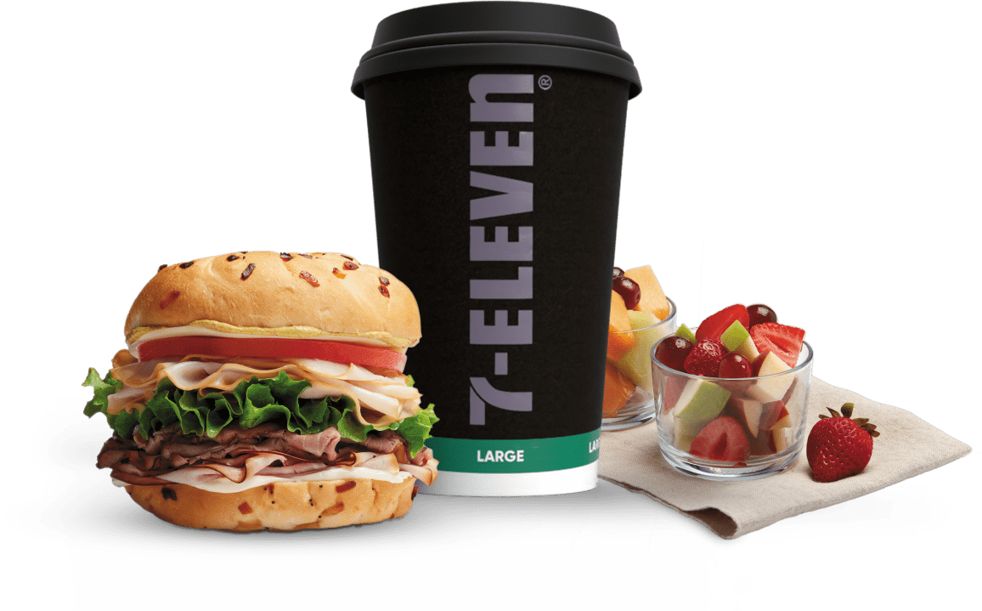
Correlation
7Eleven - Enterprise Data
Are there correlation between
2 products

Slide 25
Rfm Coffee Journey offer 1
7Eleven - Enterprise Data
When do the redeemers redeem the offer?
Treatment Group: 188,872 Loyalty Members
Control Group: 69,774 Loyalty Members
Duration: May 06th - May 15th, 2021

Slide 26
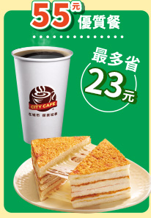
Sandwiches and Coffee
7Eleven - Enterprise Data
Will this bundle sales work in US?

Slide 27
Correlation
7Eleven - Enterprise Data
Spearman’s $ρ$ test
Weak
Negative
Correlation
Weak
Positive
Correlation
$ρ$ =-1
$ρ$ = -0.5
$ρ$ = -0.3
$ρ$ = 0
$ρ$ = 0.3
$ρ$ = 0.5
$ρ$ = 1
Perfect Negative
Correlation
No
Correlation
Perfect Positive
Correlation

Slide 28
Correlation
7Eleven - Enterprise Data
Spearman’s $ρ$ test
Moderate
Negative
Correlation
Moderate
Positive
Correlation
$ρ$ =-1
$ρ$ = -0.5
$ρ$ = -0.3
$ρ$ = 0
$ρ$ = 0.3
$ρ$ = 0.5
$ρ$ = 1
Perfect Negative
Correlation
No
Correlation
Perfect Positive
Correlation

Slide 29
Correlation
7Eleven - Enterprise Data
Spearman’s $ρ$ test
Strong
Negative
Correlation
Strong
Positive
Correlation
$ρ$ =-1
$ρ$ = -0.5
$ρ$ = -0.3
$ρ$ = 0
$ρ$ = 0.3
$ρ$ = 0.5
$ρ$ = 1
Perfect Negative
Correlation
No
Correlation
Perfect Positive
Correlation

Slide 30
Correlation
7Eleven - Enterprise Data
6am - 11am Coffee & Sandwiches

Slide 31
Correlation
7Eleven - Enterprise Data
6am - 11am Coffee & Sandwiches

Slide 32
Correlation
7Eleven - Enterprise Data
What did people buy with Coffee?

Slide 33
Correlation
7Eleven - Enterprise Data
6am - 11am Coffee & Donuts

Slide 34
Correlation
7Eleven - Enterprise Data
6am - 11am Coffee & Donuts from 01/01/2021 - 11/13/2021

Slide 35
Correlation
7Eleven - Enterprise Data
6am - 11am Coffee & Donuts Outlier

Slide 36
Correlation
7Eleven - Enterprise Data
Coffee Donuts correlation in different day part

Slide 37
Correlation
7Eleven - Enterprise Data
6am - 11am Coffee & Muffins 01/01/2021 - 11/13/2021

Slide 38
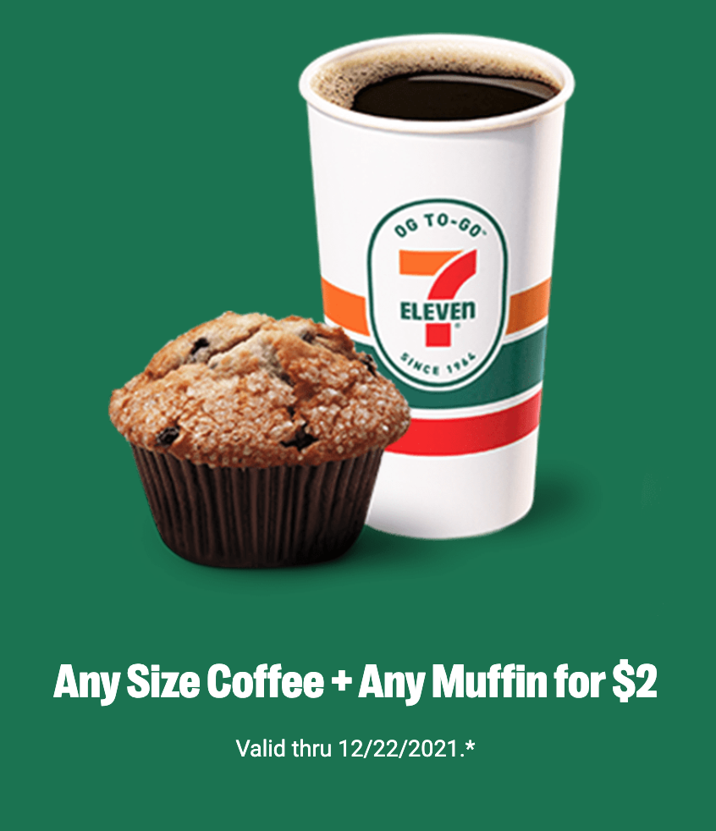
Correlation
7Eleven - Enterprise Data
6am - 11am Coffee & Muffins Outliers

Slide 39
Correlation
7Eleven - Enterprise Data
6am - 11am Coffee & Muffins 01/01/2021 - 10/31/2021

Slide 40
Intersting Findings
7Eleven - Enterprise Data
Top 4 products that correlates with Coffee from 6am - 11am

Slide 41
Intersting Findings
7Eleven - Enterprise Data
Last 4 products that correlates with Coffee from 6am - 11am

Slide 42
Conclusion
7Eleven - Enterprise Data
What role does Experimentation Platform play?
Encourage proper experiment design (Since we have exp_platform)
Provide visualization for users to quickly understand the data
Provide statistical analysis for decision making

Slide 43
7Eleven - Enterprise Data
QA

Slide 44
KPI
7Eleven - Enterprise Data
ttl sales
unq psa bought
email opened
coupon redemption rate
ttl units
unq cat bought
email open rate
Reward redemption rate
avg spend
unq subcat bought
push opened
avg units
push open rate
avg per
sales date

Slide 45
Stratified Random Sampling
7Eleven - Enterprise Data
Treatment 75%
Control 25%
Random
Split
Age > 40
Female
Age < =40
Male
Age > 40
20 Target Customers Treatment Group: 15 (75%)
Control Group: 5 (25%)
Age < =40

Slide 46
Flow
7Eleven - Enterprise Data
Stratified Random Sampling

Slide 47
ML
7Eleven - Enterprise Data
Can we add any Machine Learning to the platform
Target Customer Condition: Can we train a model that can tell who is the potential customer for the campaign
Products Correlation: Can we train a model and predict what products (category) might get affected in a campaign
Products Correlation: Can we train a model and predict the outcome of a campaign
Can we train a model so that we know where to place the products

